Slide 1
Fast evaluation of internal loops in RNA secondary structure prediction
BIOINFORMATICS Vol. 15 no. 6 1999 Pages 440-445
Rune B. Lyngso, Michael Zuker and Christian N. S. Pedersen
Speaker: Chia – Hung Chang
DATE: October 17, 2007

Slide 2
Abstract
Motivation: Though not as abundant in known biological processes as proteins, RNA molecules serve as more than mere intermediaries between DNA and proteins. Research in the last 15 years demonstrates that RNA molecules serve in many roles, including catalysis. Furthermore, RNA secondary structure prediction based on free energy rules for stacking and loop formation remains one of the few major breakthroughs in the field of structure prediction, as minimum free energy structures and related quantities can be computed with full mathematical rigor. However, with the current energy parameters, the algorithms used hitherto suffer the disadvantage of either employing heuristics that risk (though highly unlikely) missing the optimal structure or becoming prohibitively time consuming for moderate to large sequences.

Slide 3
Results: We present a new method to evaluate internal loops utilizing currently used energy rules. This method reduces the time complexity of this part of the structure prediction from O(n⁴) to O(n³), thus reducing the overall complexity to O(n³). Even when the size of evaluated internal loops is bounded by k (a commonly used heuristic), the method presented has a competitive edge by reducing the time complexity of internal loop evaluation from O(k²n²) to O(kn²). The method also applies to the calculation of the equilibrium partition function.

Slide 4
Input & Output
Input:
  A given sequence
Output:
  The most stable structure

Slide 5
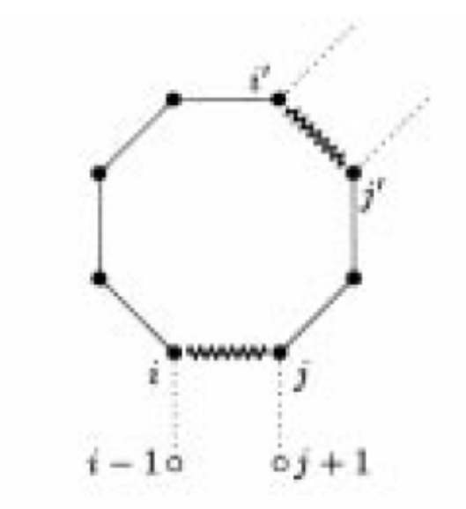
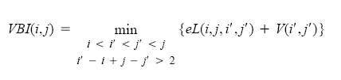
Methods
Loop ➔

Slide 6
Algorithms
The destabilizing energy can be split into contribution from:
  The size of the loop
  The asymmetry of the loop
  The stacking energies of the interior and exterior base pairs with the nearest unpaired bases

Slide 7
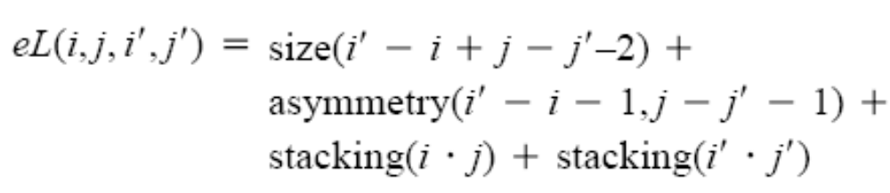
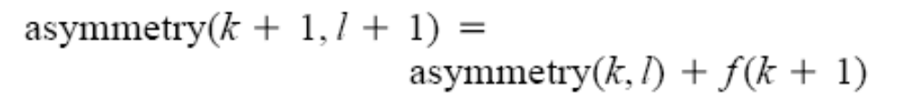
Formulae

Slide 8
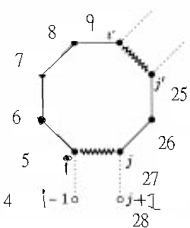
Example
eL(5,27,9,25)
=size(4)
+asymmetry(3,1)
+stacking(5,27)
+stacking(9,25)

Slide 9
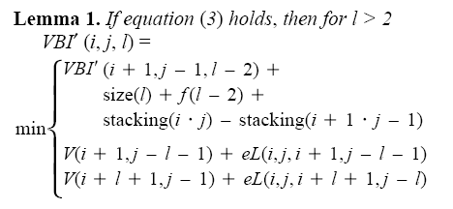
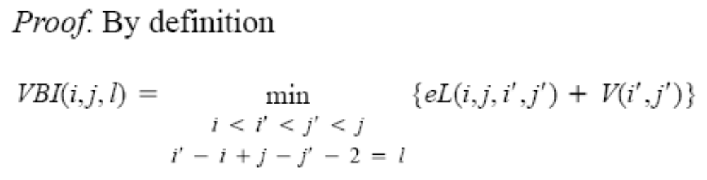

Slide 10
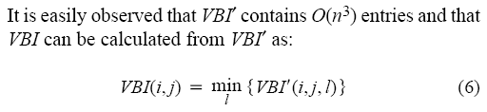

Slide 11
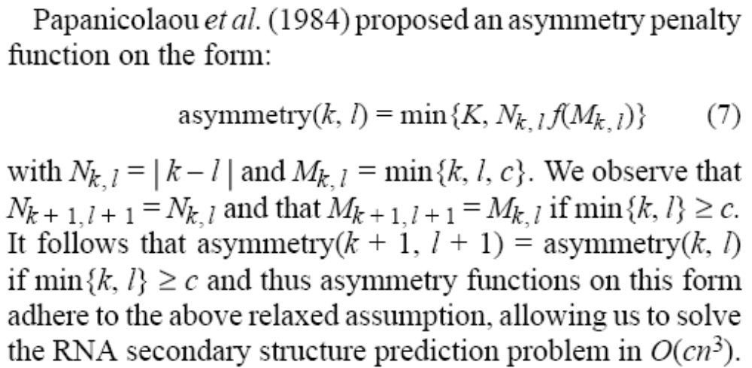

Slide 12
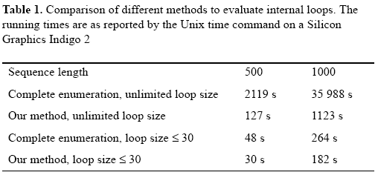
Result

